Slide 1
Game Technology
Lecture 6 – 21.11.2014
Dipl-Inf. Robert Konrad
Dr.-Ing. Florian Mehm

Slide 2
Preliminary timetable
Lecture No. | Date | Topic
1 | 17.10.2014 | Basic Input & Output
2 | 24.10.2014 | Timing & Basic Game Mechanics
3 | 31.10.2014 | Software Rendering 1
4 | 07.11.2014 | Software Rendering 2
5 | 14.11.2014 | Basic Hardware Rendering
6 | 21.11.2014 | Animations
7 | 28.11.2014 | Physically-based Rendering
8 | 05.12.2014 | Physics 1
9 | 12.12.2014 | Physics 2
10 | 19.12.2014 | Scripting
11 | 16.01.2015 | Compression & Streaming
12 | 23.01.2015 | Multiplayer
13 | 30.01.2015 | Audio
14 | 06.02.2015 | Procedural Content Generation
15 | 13.02.2015 | AI

Slide 3
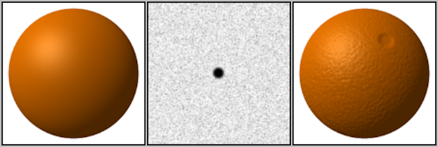
Bump Mapping

Slide 4
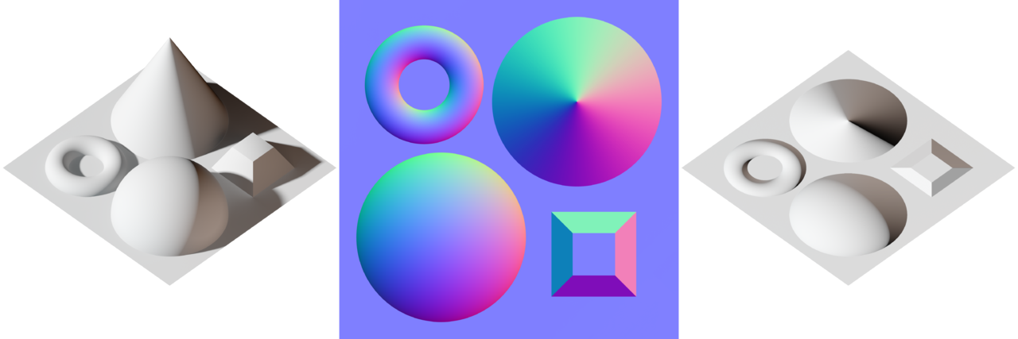
Normal Maps

Slide 5
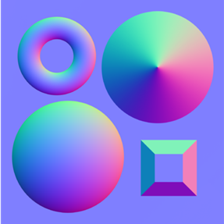
Normal Maps
normal = 2 * color - 1;

Slide 6
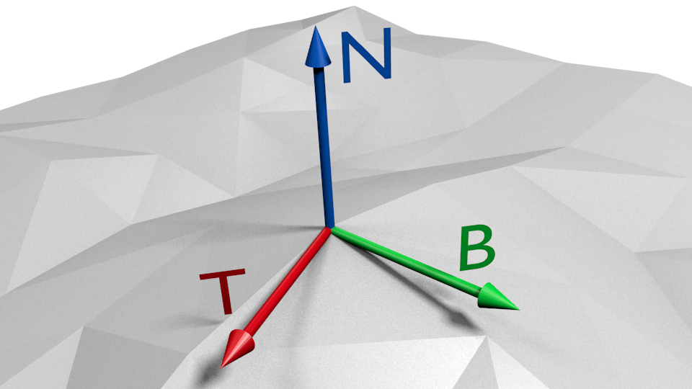
Tangent Space
Defines coordinate systems orthogonal to the surface
Reuse texture coordinates: deltaPos1 = deltaU1 * T + deltaV1 * B deltaPos2 = deltaU2 * T + deltaV2 * B
T B N T B N T B N
Notes:
Image from http://www.txutxi.com/?p=316

Slide 7
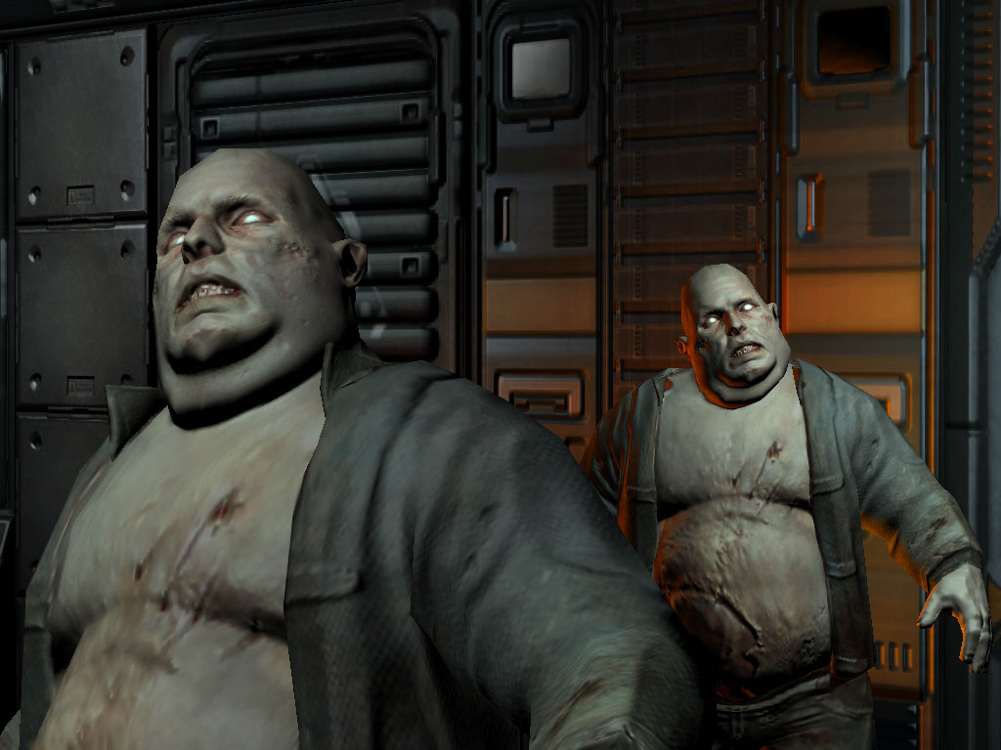
Normal Mapping

Slide 8
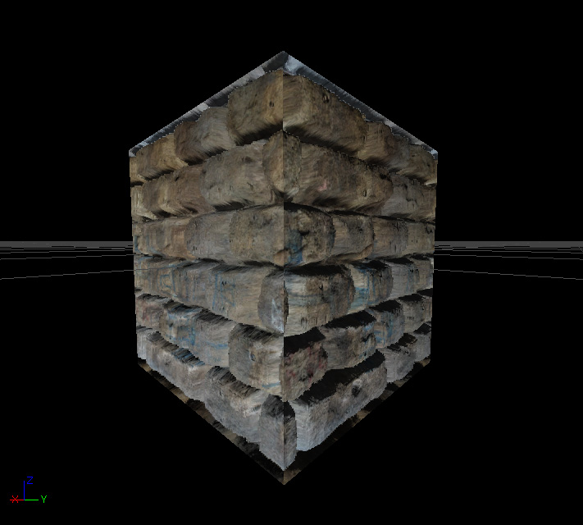
Parallax Occlusion Mapping
Notes:
Image from http://udn.epicgames.com/Three/DevelopmentKitGemsParallaxOccludedMapping.html

Slide 9


Slide 10
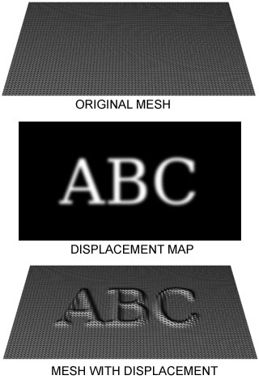
Displacement Mapping

Slide 11
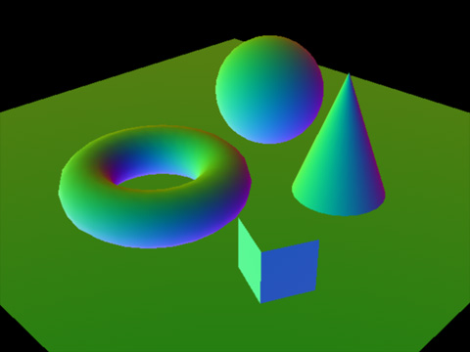
Deferred Shading

Slide 12
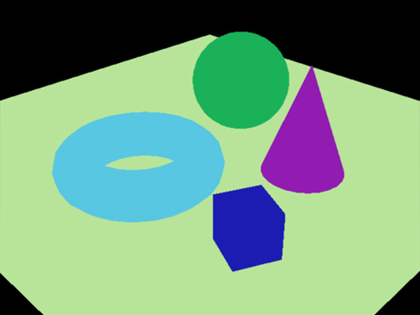
Deferred Shading

Slide 13
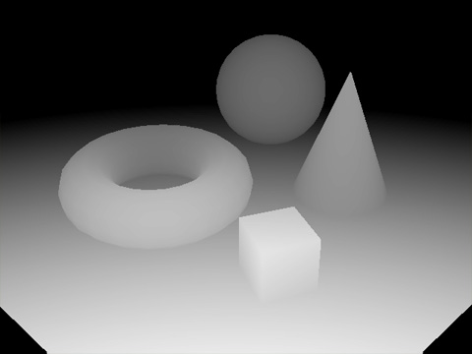
Deferred Shading

Slide 14
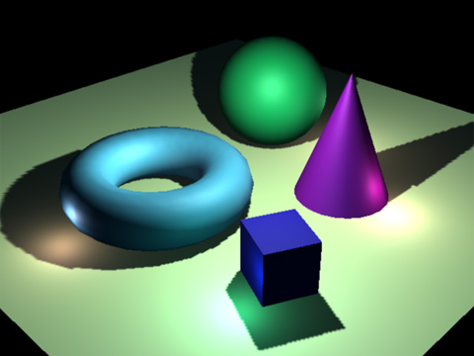
Deferred Shading

Slide 15
MVP
projection * view * model
Animate the model matrix to animate an object

Slide 16
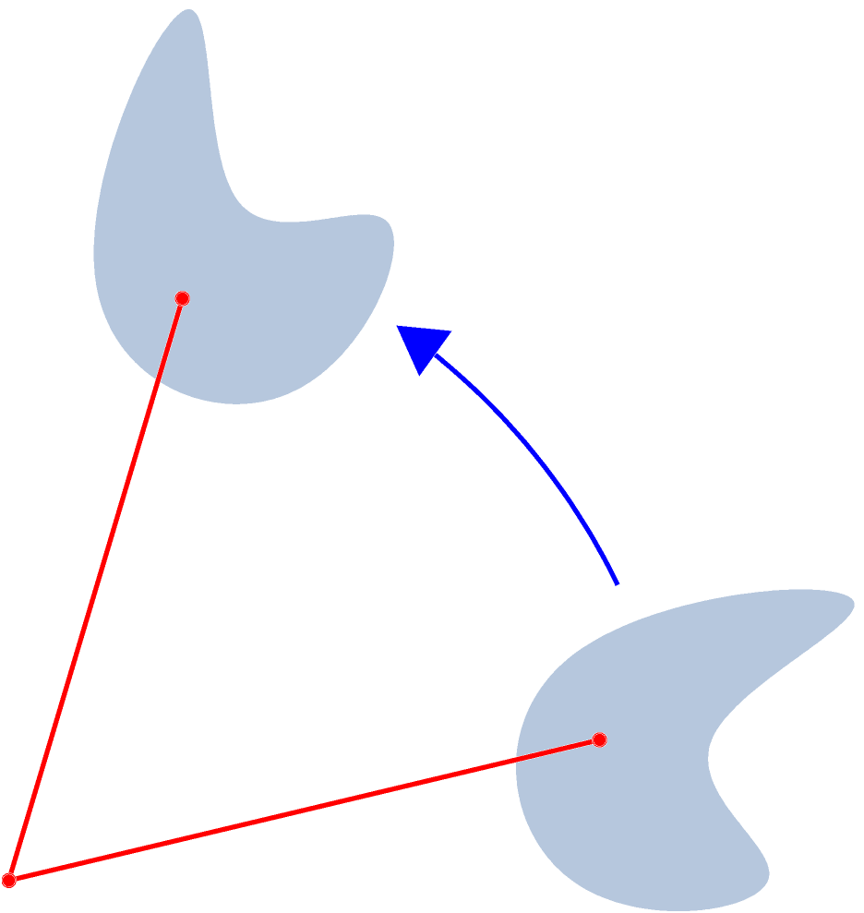
Movement and Rotation
model = (translate to end position) * rotation * (translate rotation center to 0)

Slide 17
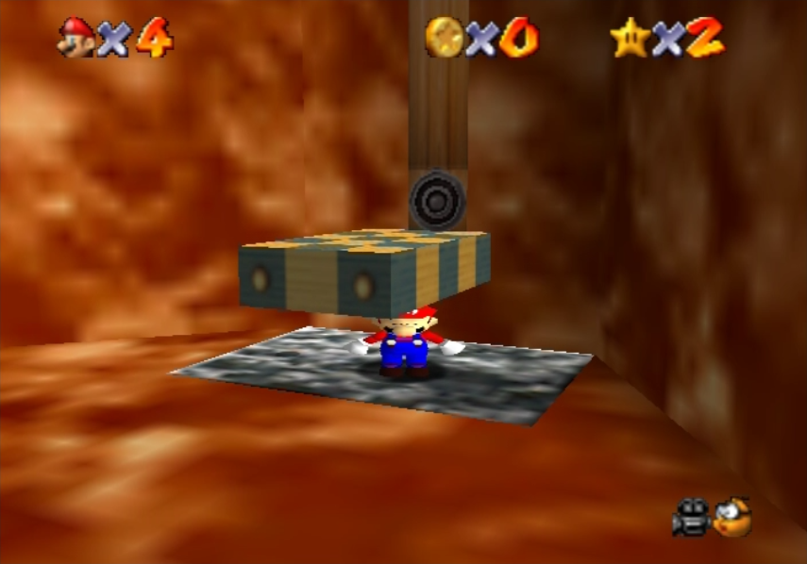
Scale

Slide 18
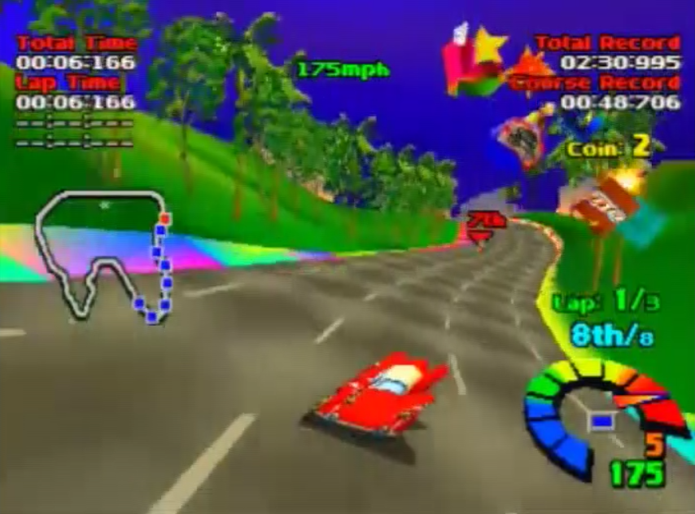
Shear

Slide 19
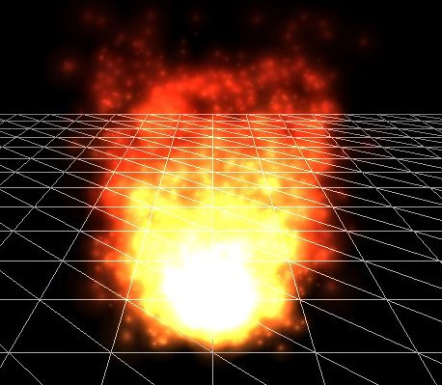
Particle Systems

Slide 20
Particle Systems
A particle is (mostly)
Just an image
„Billboards“
One texture, two triangles
Always rotated to camera
Use inverse of view matrix

Slide 21
Particle Systems
Emitter
Source of particles
Animation
Use super simple physics
Constant speed or constant speed & gravity
Fade out
alpha = 1 - time / max_time

Slide 22

Particle Systems

Slide 23
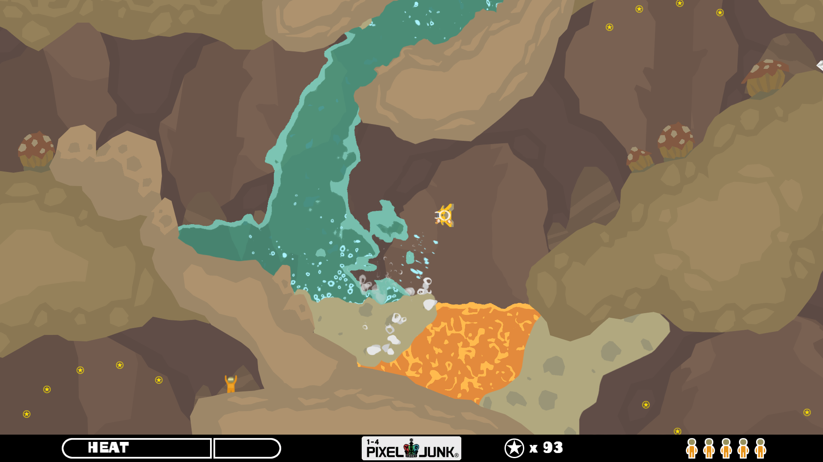
Fluids

Slide 24
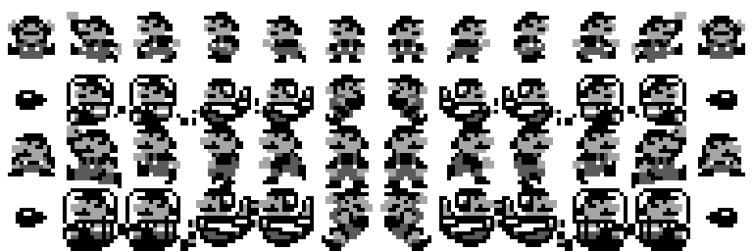
Sprite Sheets

Slide 25

Vertex Animations

Slide 26
Vertex Animations
100 frames * 100000 vertices = lots of data

Slide 27

Blend Vertex Positions

Slide 28
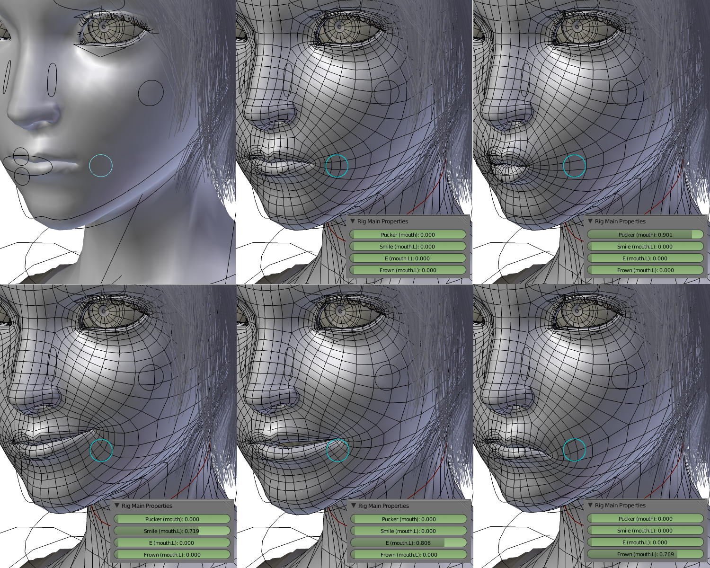
Faces
Morph target animation

Slide 29
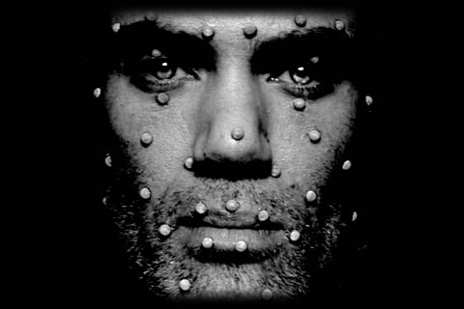
Performance Capture

Slide 30
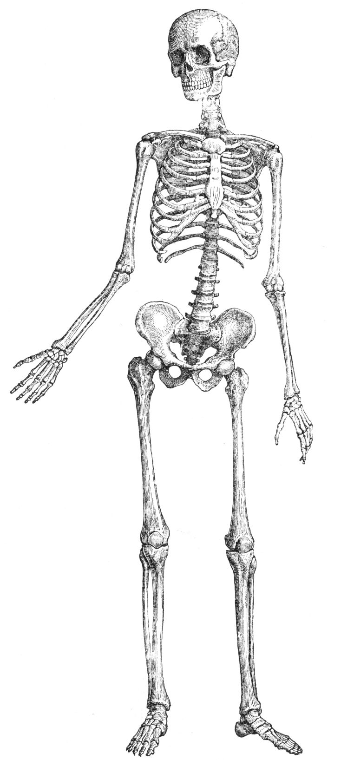
Skeletal Animation

Slide 31

Skeletal Animation

Slide 32
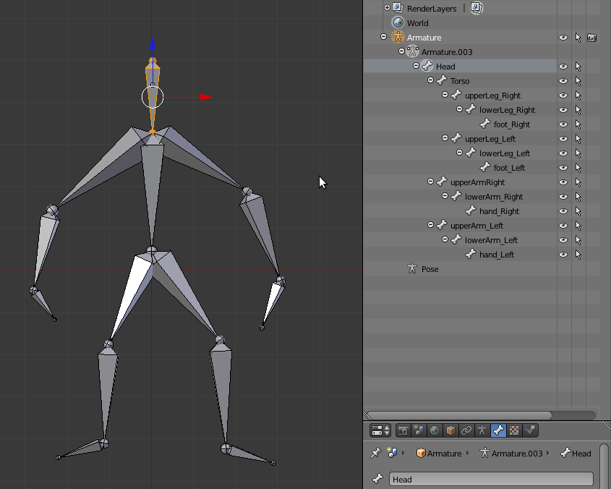
Skeletal Animation
Notes:
From http://gamedev.stackexchange.com/questions/24911/how-to-make-leg-bones-children-of-torso-bone-in-blender

Slide 33
Skeletal Animation
One bone – One Transformation matrix
Or just a rotation
Depends on your gfx tool
Animation
Just an array of small transformation matrix arrays
Framerate can be low
Interpolation works fine

Slide 34
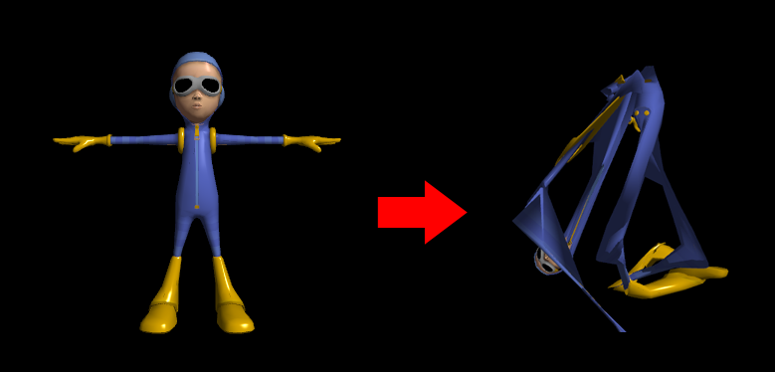
Skinning
Notes:
http://www.gamedev.net/topic/613146-skeletal-animation-problems/

Slide 35
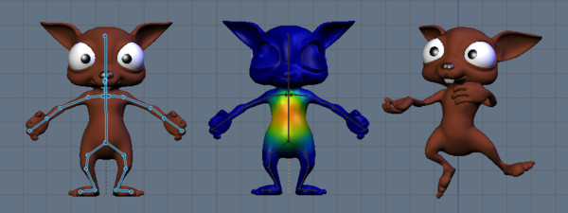
Skinning
Notes:
Image from http://archive.blender.org/development/release-logs/blender-246/skinning/index.html

Slide 36
Skinning
For each vertex
Array of (weight, index)
At start
Compute inverse of every bone transform matrix
For animation step
Compute new transform matrices
For each bone compute new transform * old inverse
For each vertex
For each weight
Compute (new transform * old inverse * vertex) * weight
Sum it up

Slide 37

Motion Capturing

Slide 38
Inverse Kinematics
Forward Kinematics
Input: Bone rotations
Output: Final positions
Inverse Kinematics:
Input: Final positions
Output: Bone rotations

Slide 39
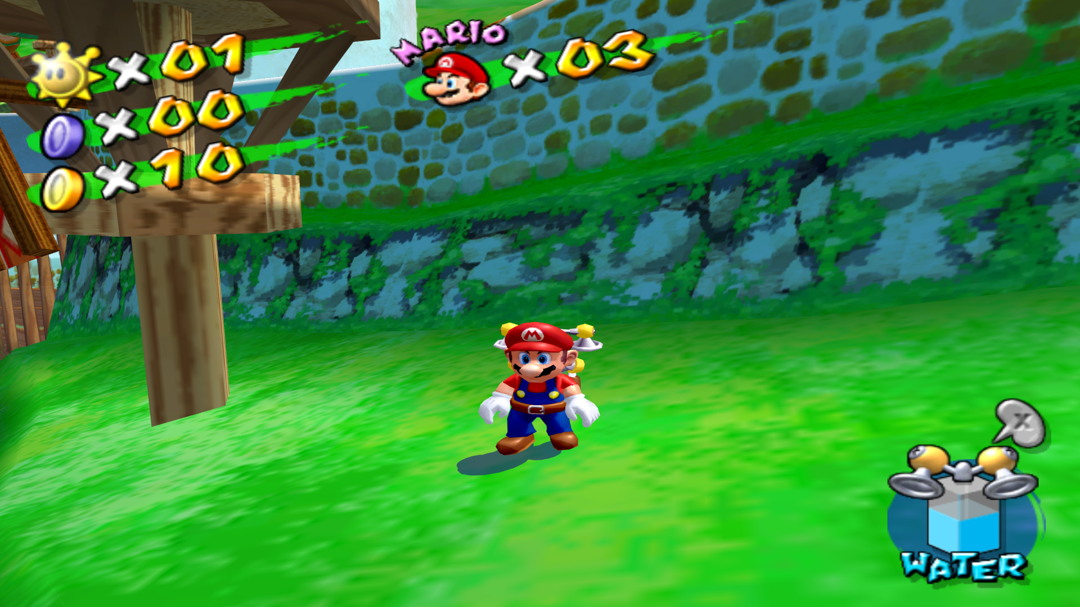
Inverse Kinematics

Slide 40
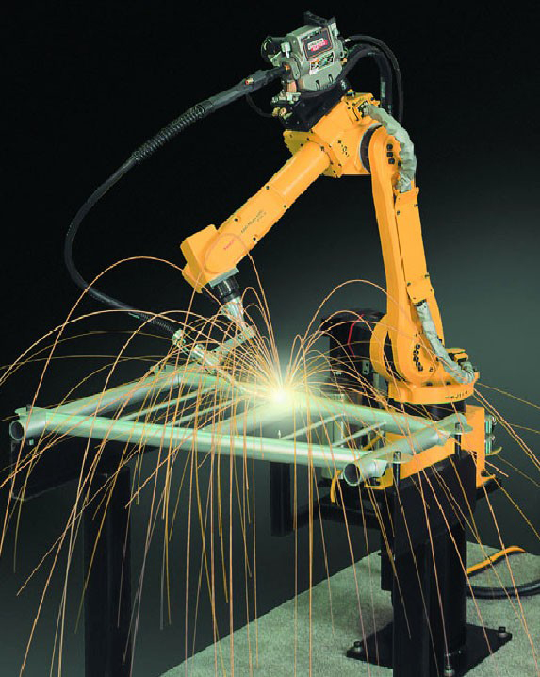
Inverse Kinematics
Numerical, iterative solution using Jacobi Matrix
See Robotics Lecture

Slide 41
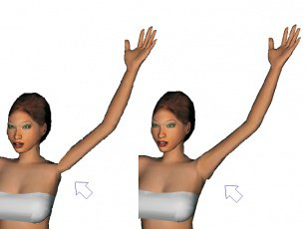
Unexpected Deformations
„Achselhölle“
Spherical Skinning
http://www.crytek.com/download/izfrey_siggraph2011.pdf
Notes:
Image from http://dcgi.felk.cvut.cz/publications/2005/kavan-i3d-sbs

Slide 42
Muscles

Slide 43
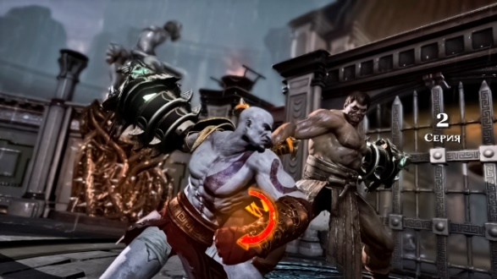
Muscles

Slide 44
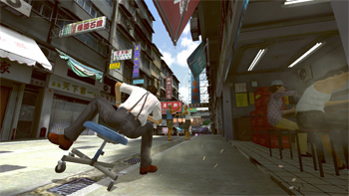
Physical Animations
Notes:
Kung Fu Rider

Slide 45

Hair, Cloth,…

Slide 46

Rag Dolls

Slide 47
Rag Doll <-> Skeletal Animation
Player hit -> rag doll simulation
Wait
Blend from current positions to nearest known animation state
Play animation

Slide 48
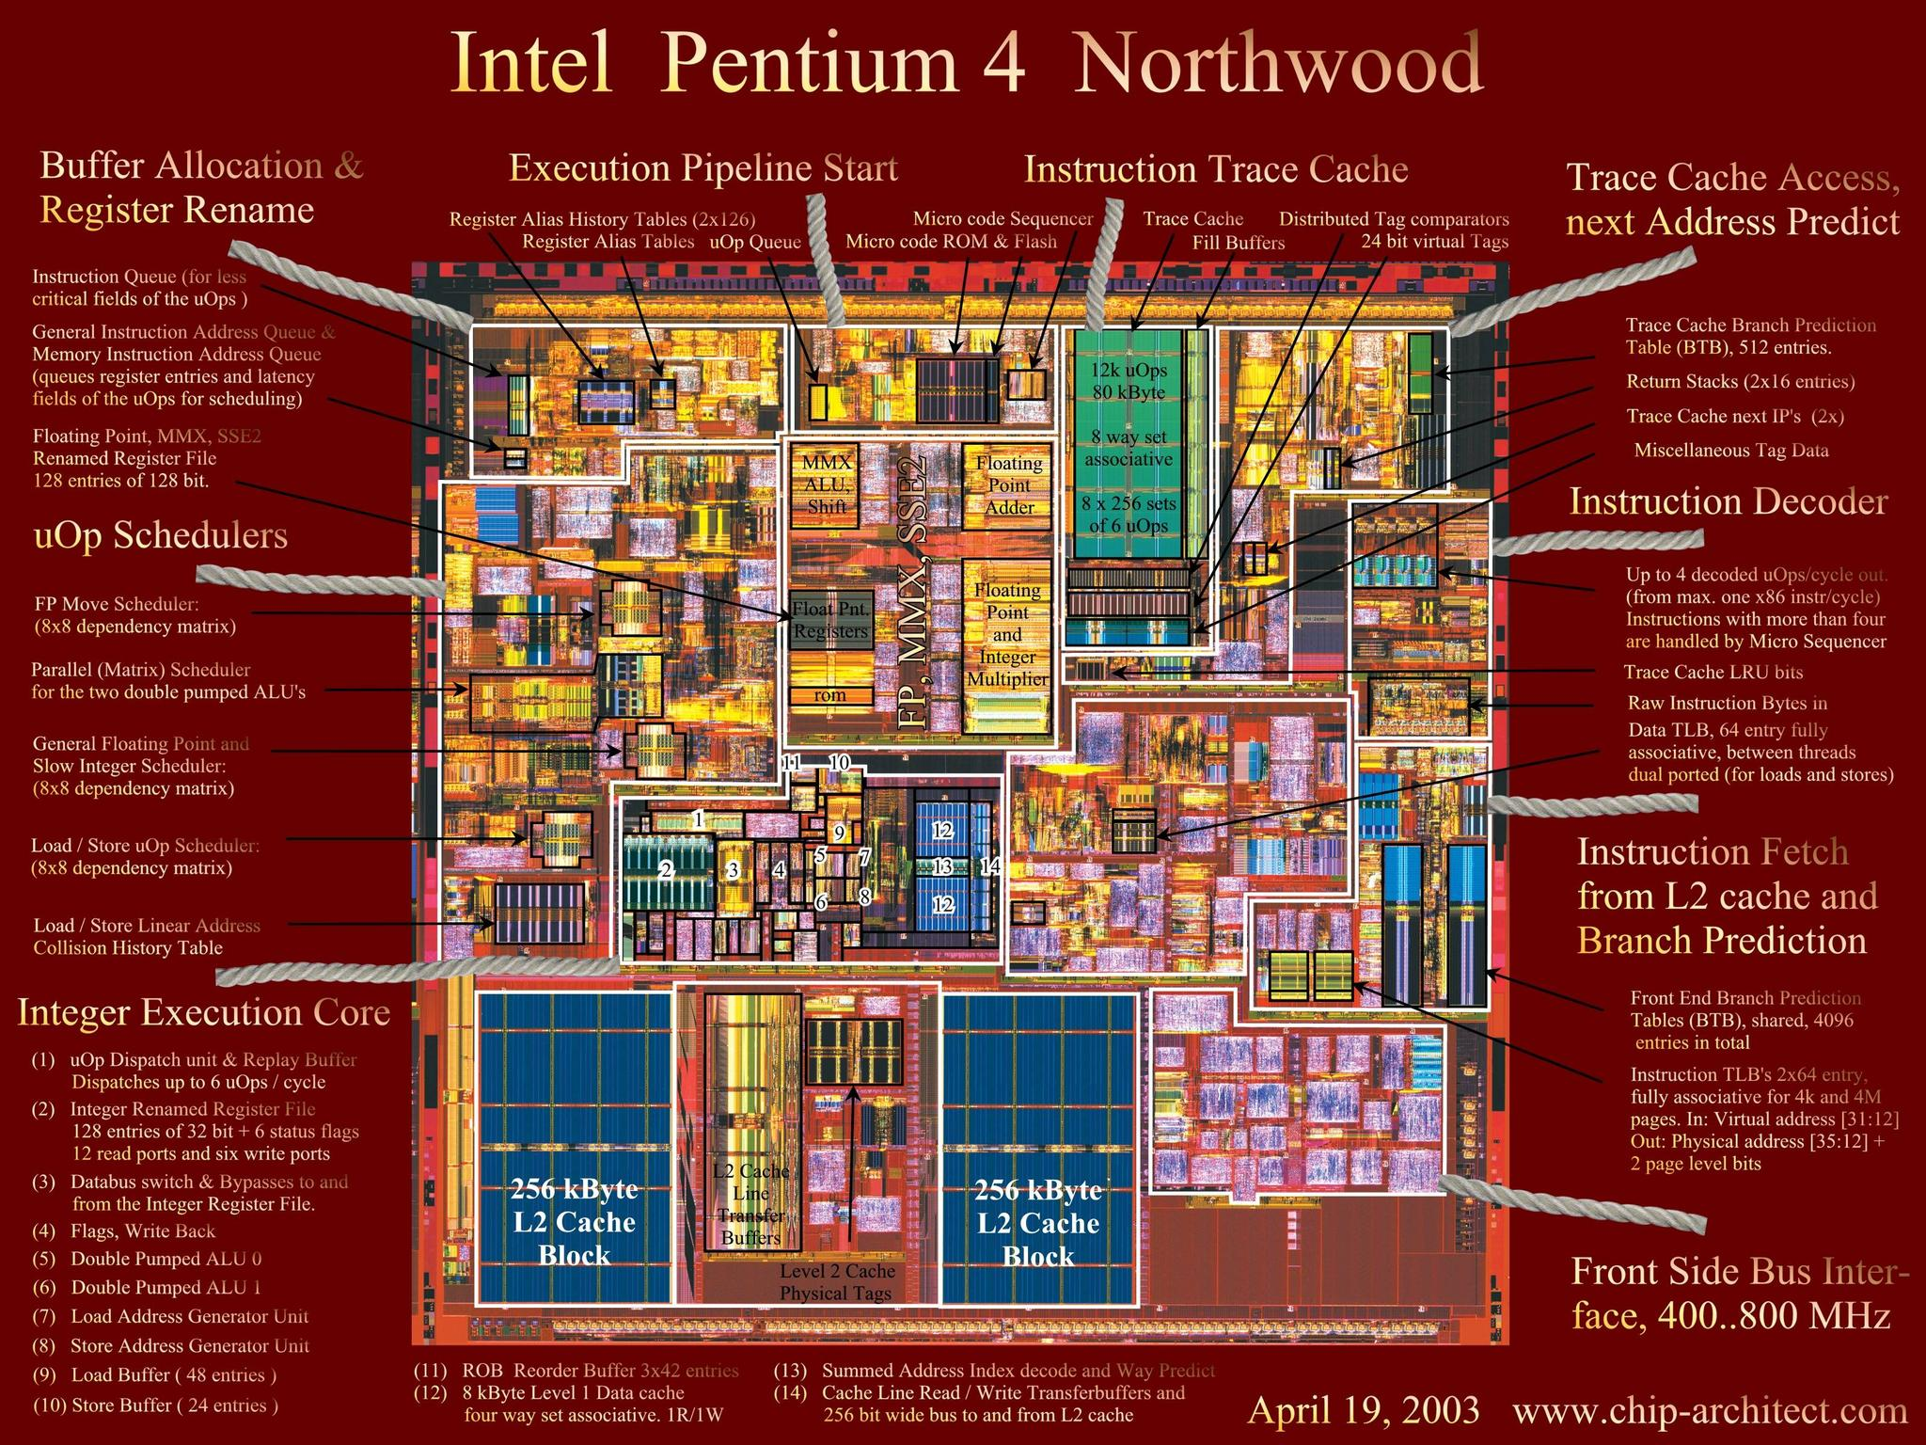
CPU internals
Notes:
8086

Slide 49
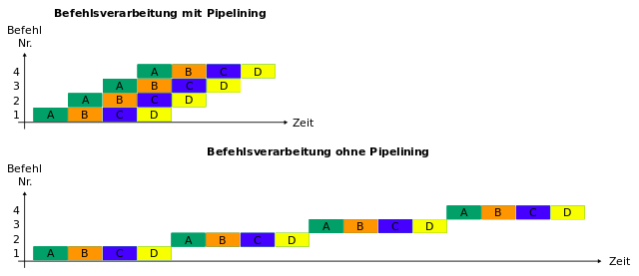
Pipelining

Slide 50
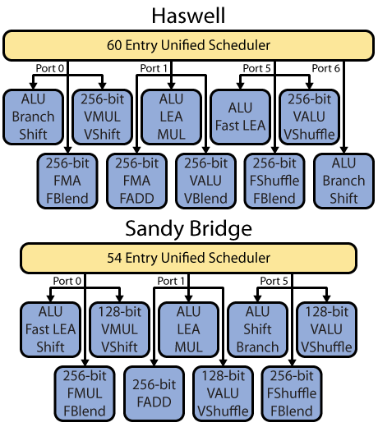
Multiple Execution Units
„ Note that Figure 3 does not show every execution unit, due to space limitations.“ (from http://www.realworldtech.com/haswell-cpu/4/)

Slide 51
Hazards
Structural Hazards
Out of hardware
Data Hazards
Data dependencies
Control Hazards
Dynamic branching

Slide 52
Structural Hazards
Modern CPUs add more ALUs
Already at a very high level

Slide 53
Data Hazards
Sometimes just register uses, not real data dependencies
subl rax, rbx addl rcx, rax
subl rcx, rax addl rbx, rax
-> Register renaming
CPU uses more registers internally than can be directly addressed

Slide 54
Data Hazards
Compiler can help
Reorder instructions
Depends highly on CPU
Out-of-Order CPUs
Can reorder instructions themselves
Can incorporate current situation in decisions
All current x86 CPUs are out-of-order
More and more ARM CPUs are out-of-order
PS360 are in-order

Slide 55
Control Hazards
Speculative execution
Branch Prediction more and more sophisticated

Slide 56
int main() { // generate data const unsigned arraySize = 32768; int data[arraySize]; for (unsigned c = 0; c < arraySize; ++c) data[c] = std::rand() % 256; // !!! with this, the next loop runs faster std::sort(data, data + arraySize); // test clock_t start = clock(); long long sum = 0; for (unsigned i = 0; i < 100000; ++i) { // primary loop for (unsigned c = 0; c < arraySize; ++c) { if (data[c] >= 128) sum += data[c]; } } double elapsedTime = static_cast<double>(clock() - start) / CLOCKS_PER_SEC; std::cout << elapsedTime << std::endl; std::cout << "sum = " << sum << std::endl; }
Notes:
http://stackoverflow.com/questions/11227809/why-is-processing-a-sorted-array-faster-than-an-unsorted-array
~10x

Slide 57
Memory Access
Cache Hierarchy critical for performance
L1 cache ~ KiloBytes
L2 cache ~ MegaBytes
Main memory ~ GigaBytes
L1 cache ~ 0.5 ns
L2 cache ~ 7 ns
Main memory ~ 100 ns

Slide 58
Memory Access
Access pattern prediction
Works best when data is reused or for sequential data reads
Cache Lines
Memory read in blocks
~ 64 Bytes
Proper data alignment can help

Slide 59
POD
„Plain old data“
struct Data { int a; float b; };
Predictable data structures
No constructor calls during array allocation
No additional data for virtual function pointers
Data data[64];
Linear data of 64*sizeof(Data) bytes

Slide 60
Memory alignment
Add unused data
Use system specific things
posix_memalign(..)
Use alignas in C++ 11
struct alignas(16) Data { int a; float b; };
alignas(128) char cacheline[128];

Slide 61
Premultiplied Alpha
White Pixel, transparent pixel
source alpha * new pixel + (1 - source alpha) * old pixel
new pixel + (1 - source alpha) * old pixel
(1, 1) (1, 0) -> (1, 0.5) -> 0.5 (source alpha * new pixel)
(1, 1) (0, 0) -> (0.5, 0.5) -> 0.25 (source alpha * new pixel)
(1, 1) (0, 0) -> (0.5, 0.5) -> 0.5 (new pixel)

Slide 62
Premultiplied Alpha
Grey Pixel, transparent pixel
source alpha * new pixel + (1 - source alpha) * old pixel
new pixel + (1 - source alpha) * old pixel
(0.5, 1) (1, 0) -> (0.75, 0.5) -> 0.375 (source alpha * new pixel)
(0.5, 1) (0, 0) -> (0.25, 0.5) -> 0.125 (source alpha * new pixel)
(0.5, 1) (0, 0) -> (0.25, 0.5) -> 0.25 (new pixel)
(0.5, 1) (0.5, 0) -> (0.5, 0.5) -> 0.25 (source alpha * new pixel)

Slide 63
Blending Order
source alpha * new pixel + (1 - source alpha) * old pixel
a * n + (1 - a) * o
a2 * n2 + (1 - a2) * (a1 * n1 + (1 - a1) * o)
a2*n2 + a1*n1 + o - a1*o - a1*a2*n1 - a2*o + a1*a2*o
source alpha * new pixel + old pixel
a * n + o
a2 * n2 + (a1 * n1 + o)
= a1 * n1 + a2 * n2 + o

Slide 64
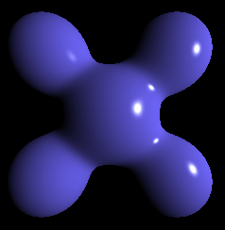
Phong Lighting
Reflects only light sources
Expects light sources to be round

Slide 65
Roughness
Use mip mapped cube map
Choose mip map level based on roughness
Higher mip level -> blurrier -> increased roughness

